Slide 1
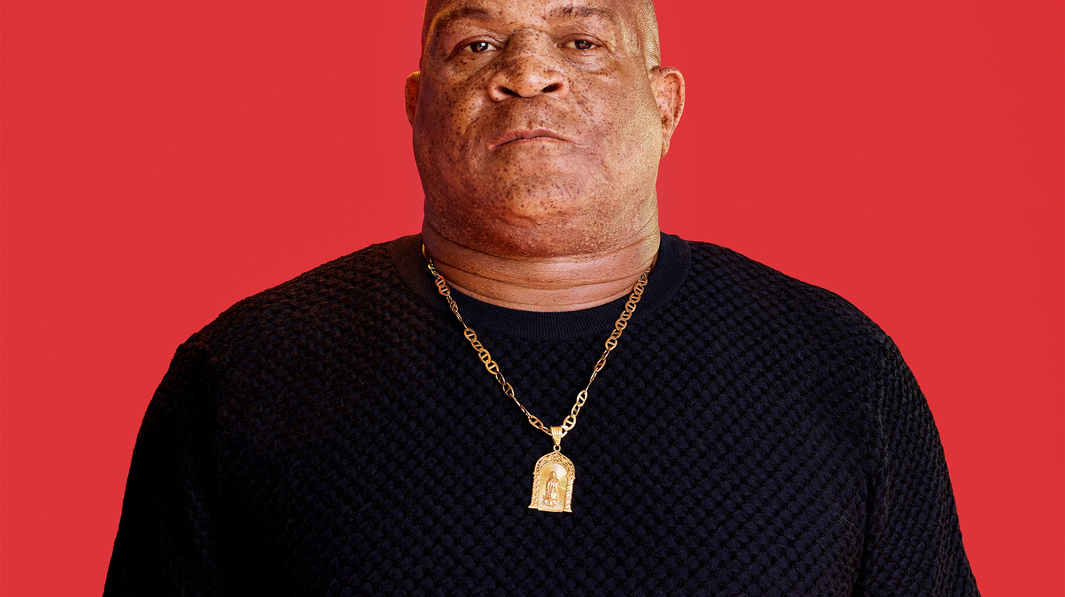



Justice for George 846: A conversation about Justice and Equality
Black History Month Speaker
Virtual Event:
Wednesday, January 27th
6:30 pm – 8:00 pm
Register through mines link!
Presented by the National Society of Black Engineers (NSBE), the Center for Inclusion, & Hardrocker Athletics

